Slide 1
Computer Graphics Project - Raindrop Simulation
張圜華、張瑜真、蔡雨芝

Slide 2
Outline
Flocking Algorithm
Cohesion
Alignment
Separation/Avoidance
Raindrop in Unity
Implementation method
Conclusion

Slide 3
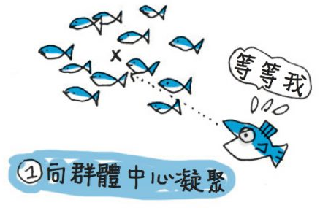
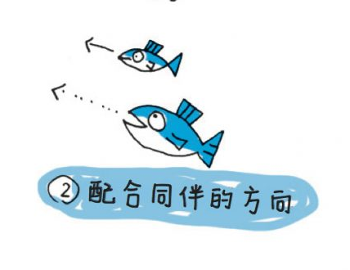
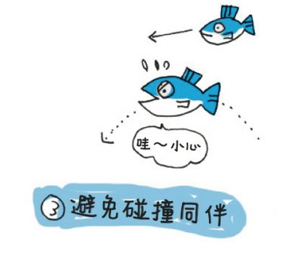
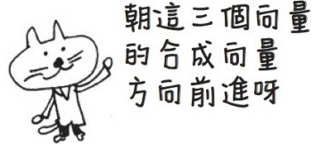
Flocking Algorithm
Cohesion
Alignment
Avoidance
朝向群體質心
最大限度地减少離群可能
以附近其他 flock 單元的
平均方向/速度飛行
移動中
避免與其他 flock 單位太接近

Slide 4
Subject to Raindrop …
Cohesion
Alignment
Combination
粒子重疊形成較大雨滴

Slide 5
Raindrop in Unity
Raindrop Implementation

Slide 6
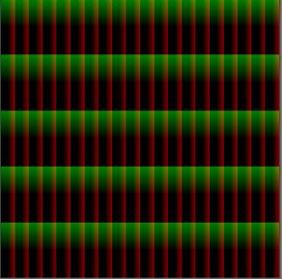
Rasterized

Slide 7
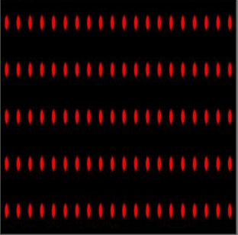
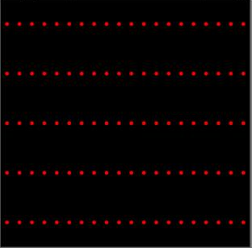
Draw the main raindrops & Deform

Slide 8
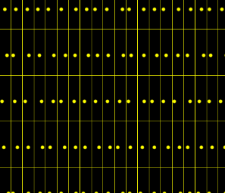
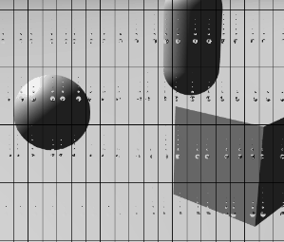
Move the lattice

Slide 9
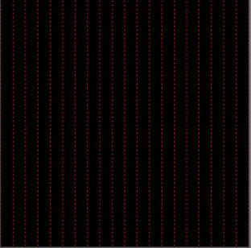
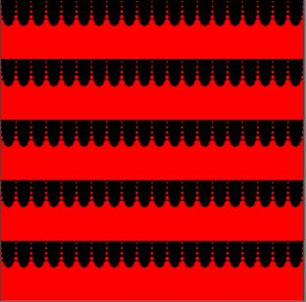
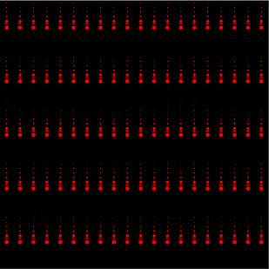
Draw the trail

Slide 10
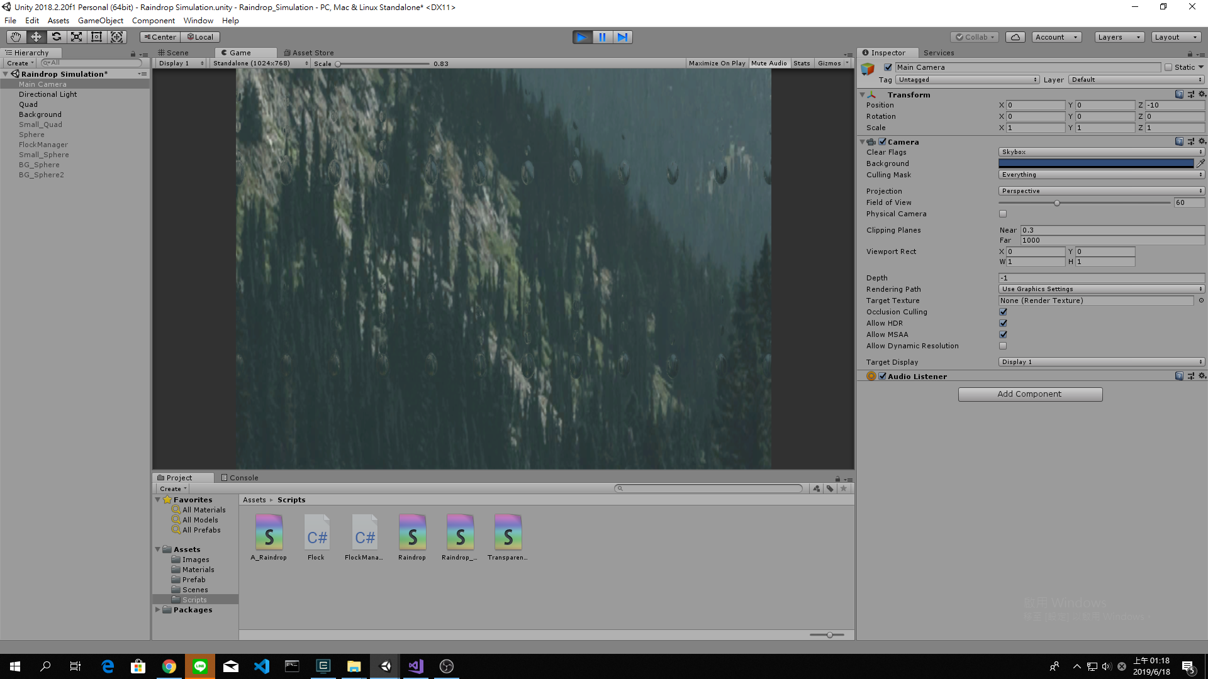
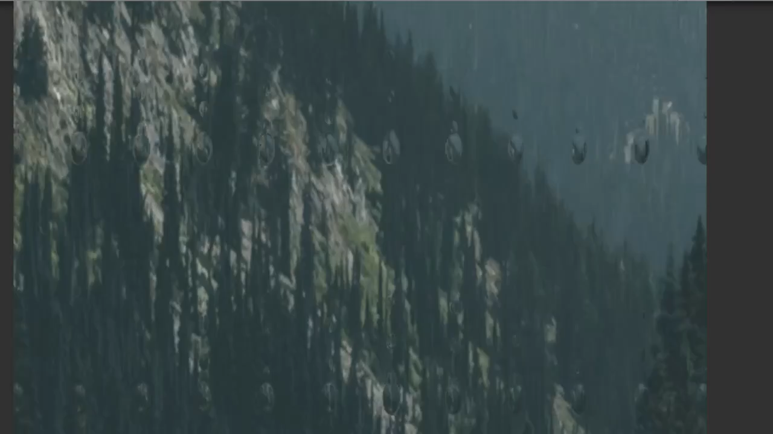
Draw the trail

Slide 11
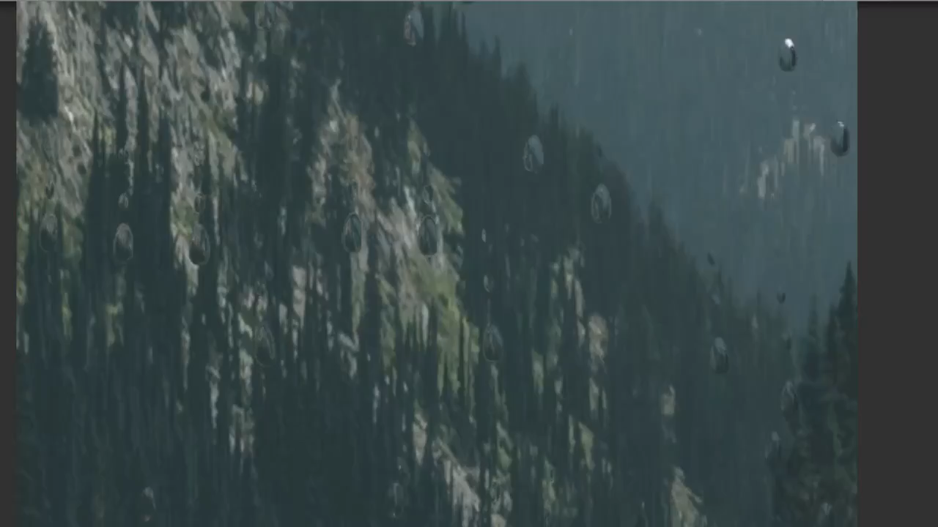
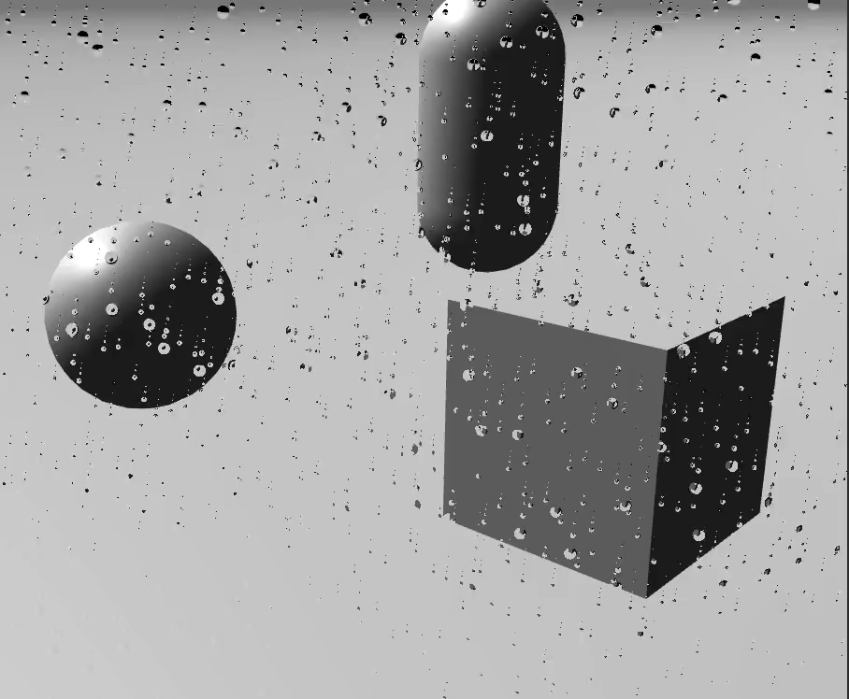
2D Raindrop in Unity

Slide 12
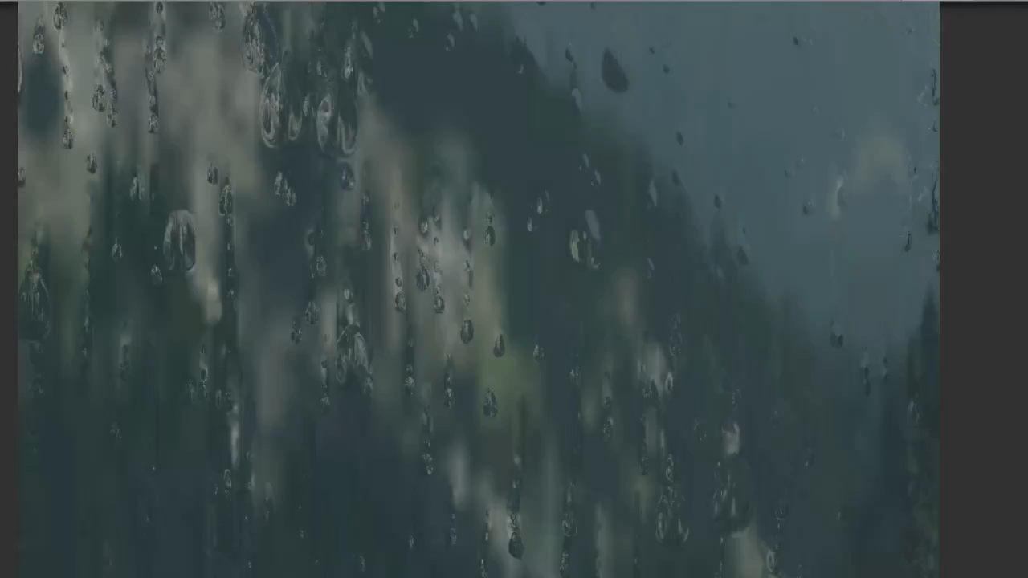
2D Raindrop in Unity

Slide 13
Combination
Raindrop
Alignment
Flocking
Algorithm

Slide 14
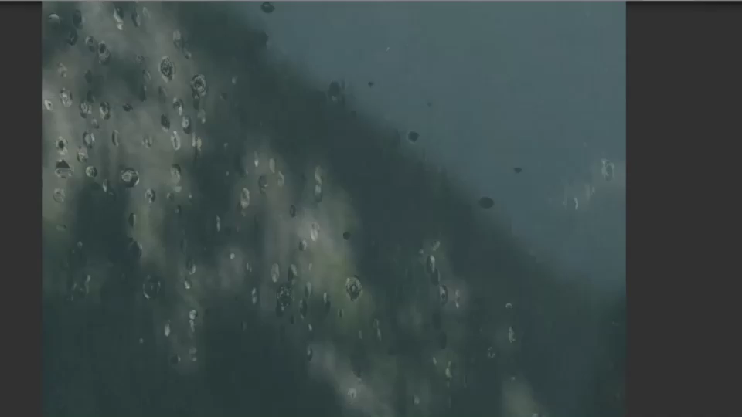
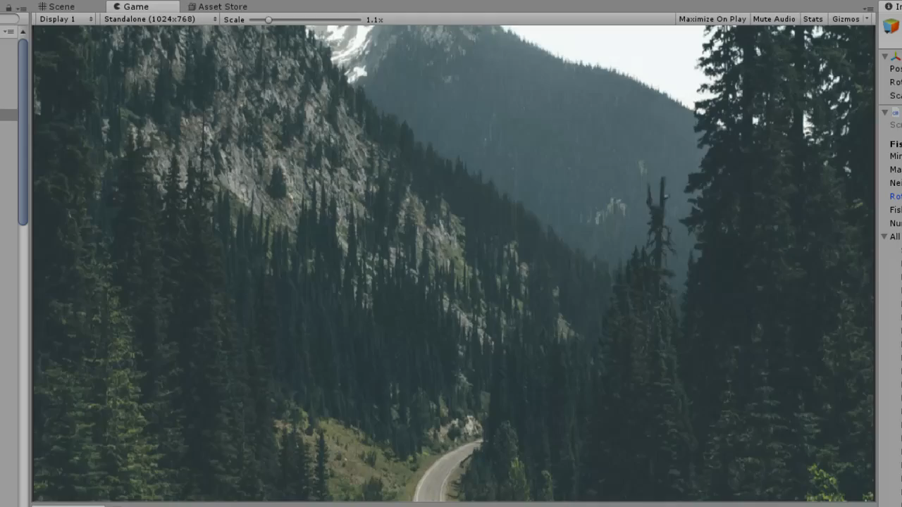
Combination
Raindrop
Alignment
Flocking
Algorithm

Slide 15
Ａｎｙ ｑｕｅｓｔｉｏｎ？

